Slide 1
Board Games Extravaganza
Kornel Krysiak & Michał Szłański

Slide 2
Big BoardGame-a
Like Big Pharma, but lamer

Slide 3
How to make it big
In Board Games

Slide 4
First, few words on the dataset
17 000 board games from Board Game Geek.
All have > 30 reviews.
Also: 13 000 000 reviews, each with a number and optionally a comment.
Source: https://www.kaggle.com/jvanelteren/boardgamegeek-reviews
Collected in 2019.

Slide 5
Let’s see the data.

Slide 6
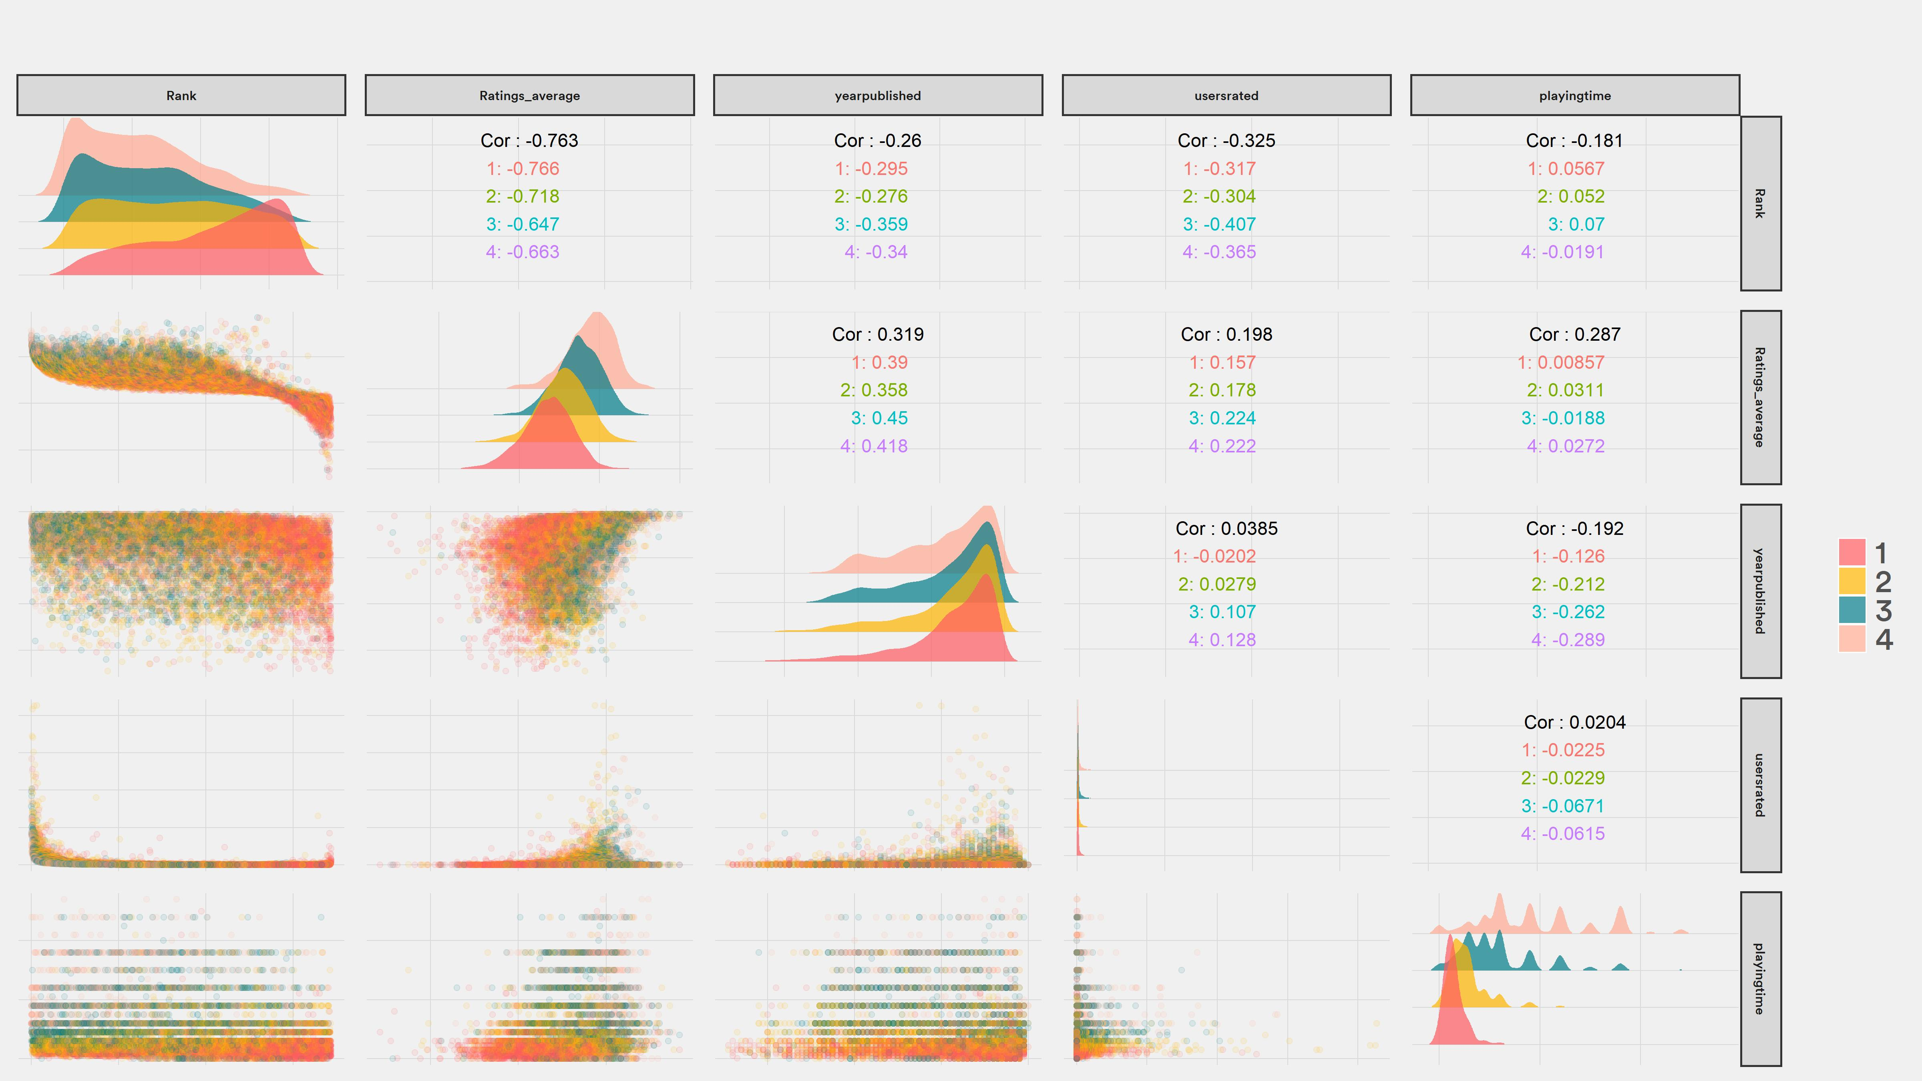

Slide 7
Interesting.

Slide 8
Are there more games each year?

Slide 9
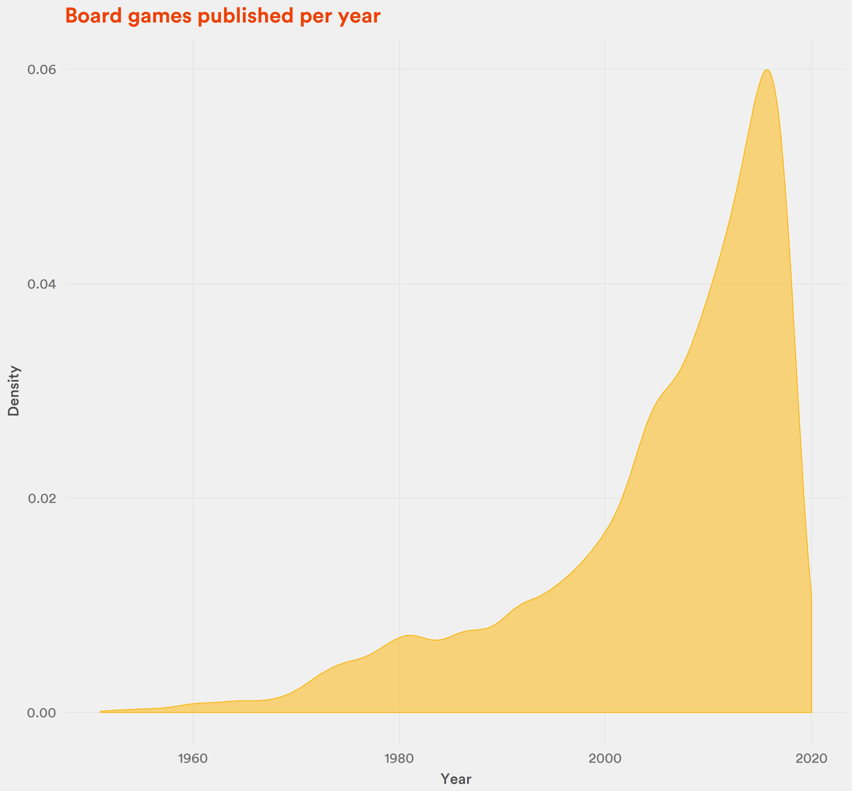
Definitely.
Compared to 2000, the number of games published in 2019 nearly tripled.

Slide 10
But, are they getting better?

Slide 12
It looks like there is some positive effect for games that came out max 3-4 years ago. Also, notice the preorder hype.

Slide 13
Board Game Geek is quite a „nerdy” place. Do less complex, „party” games get lower scores?

Slide 14
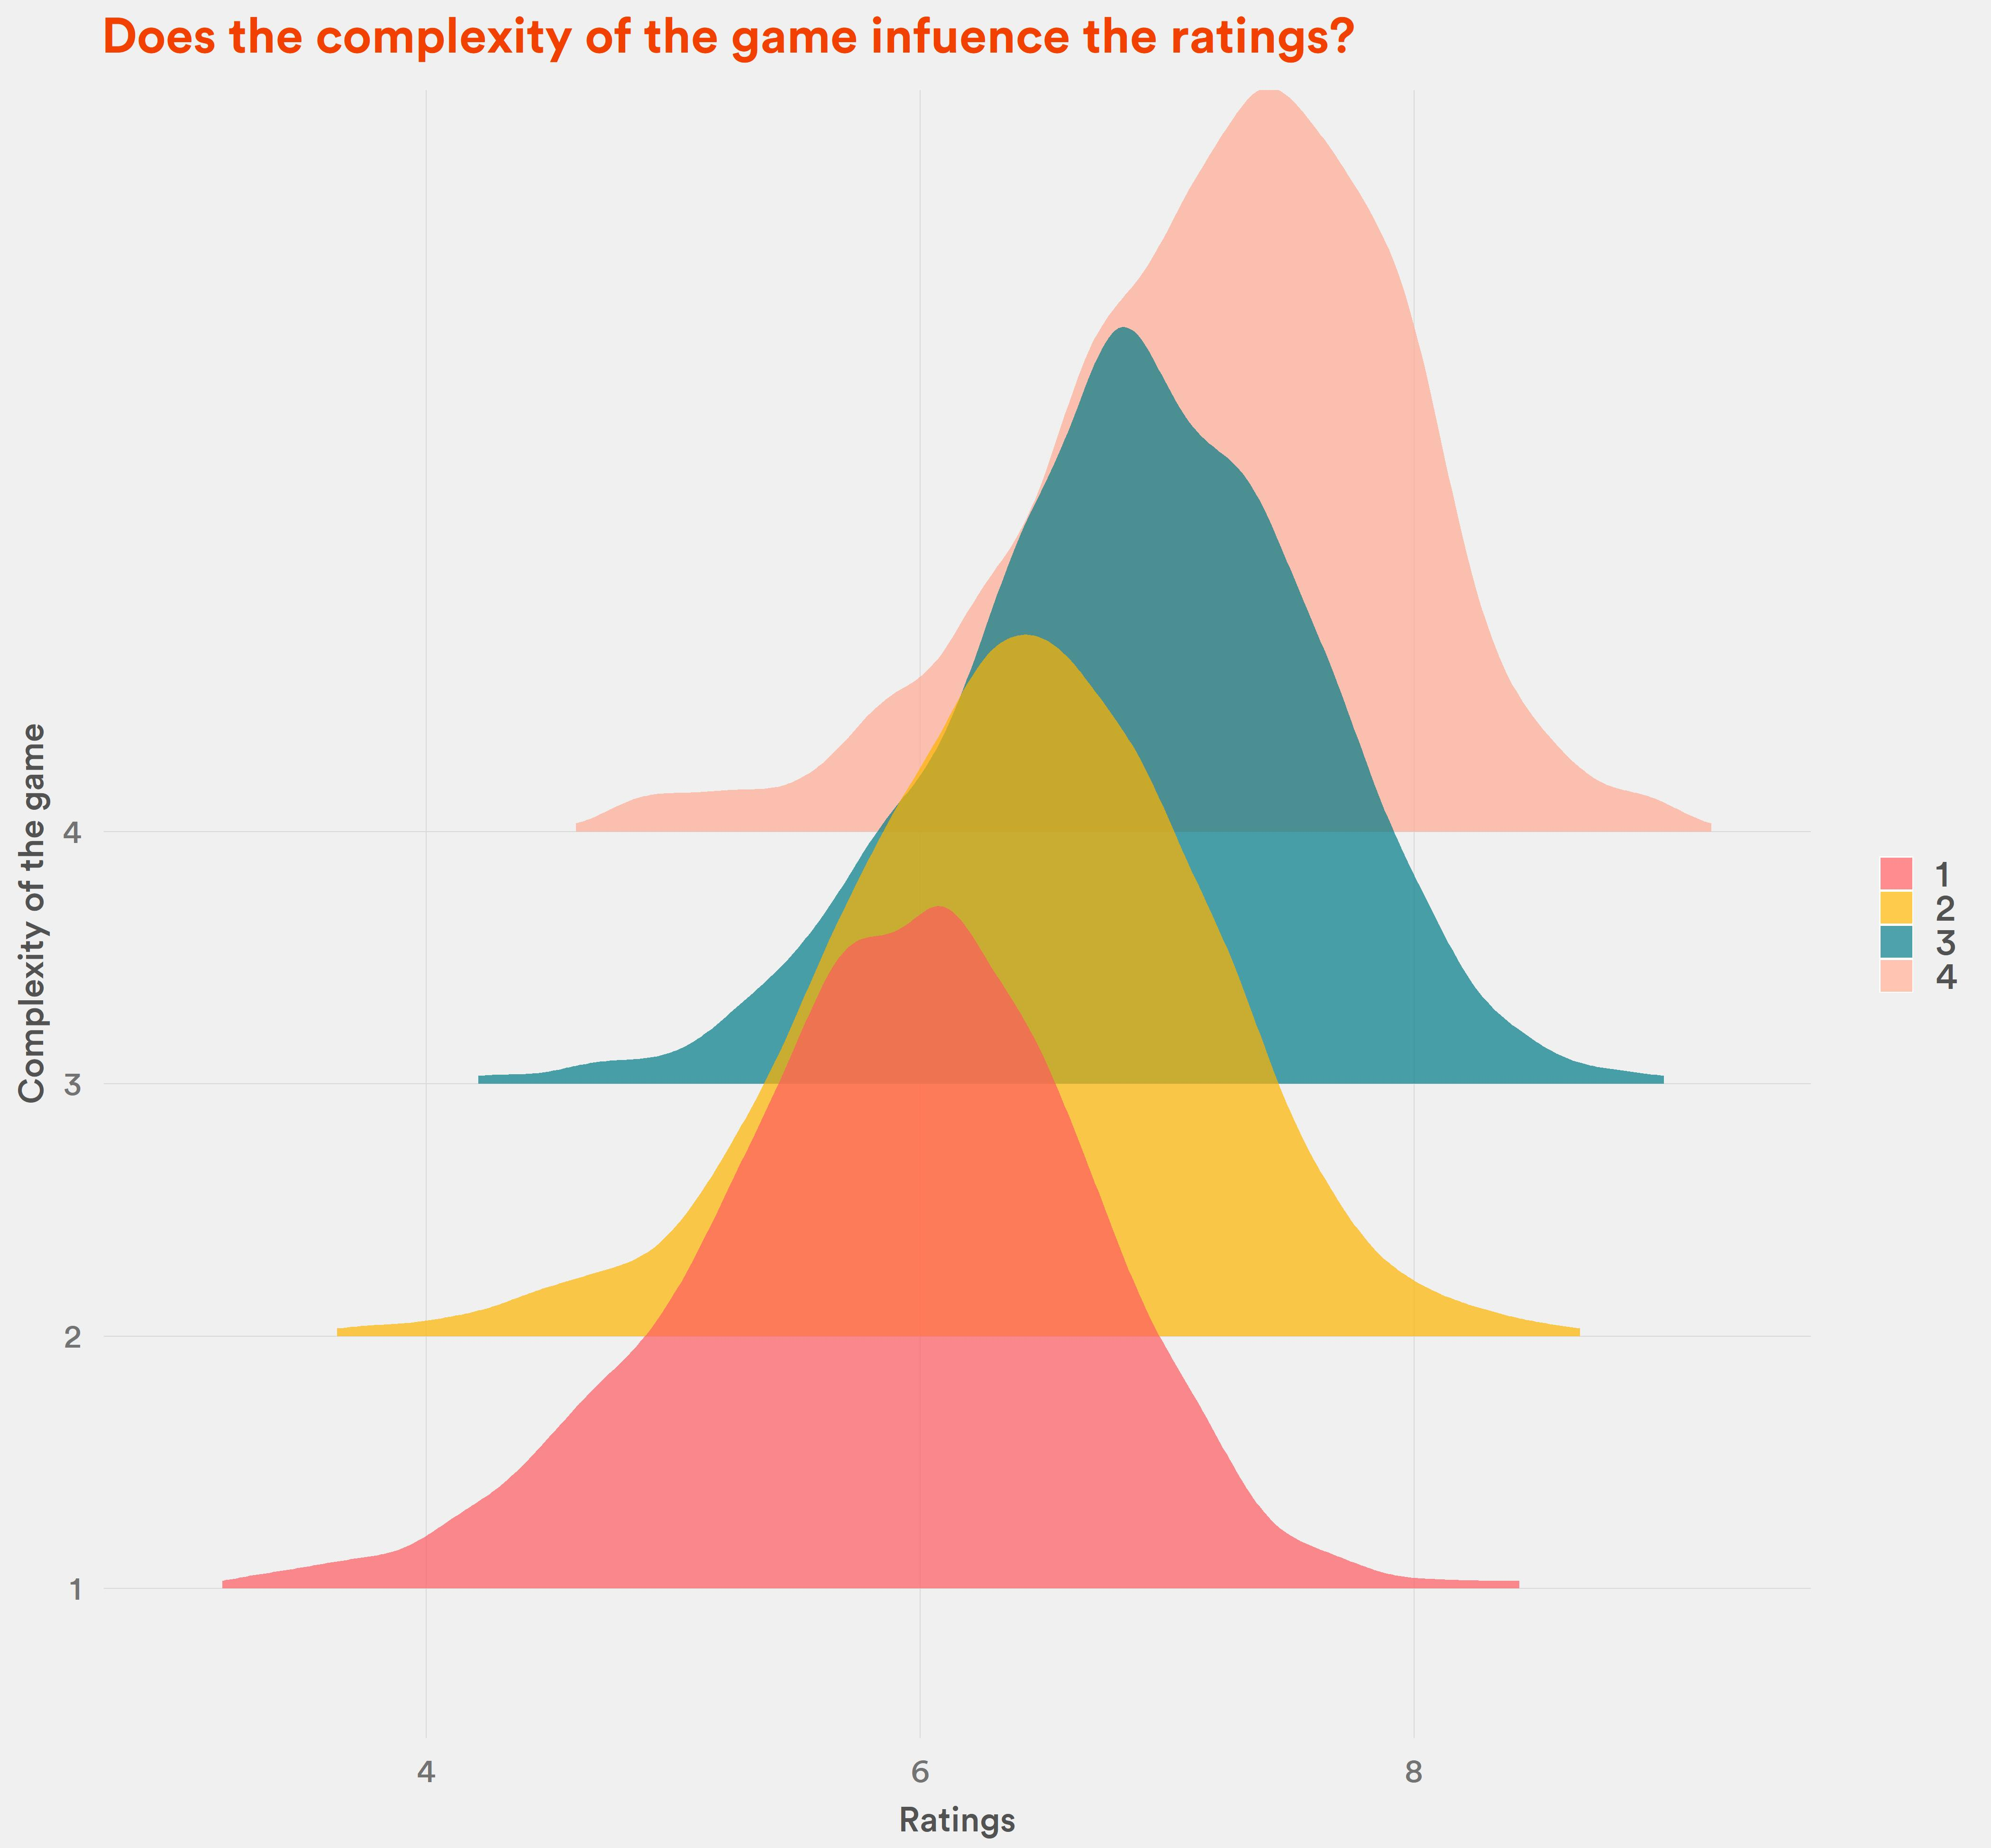
Yes.
Simple games are rated at around 6.
Very complex games: at 7.5

Slide 15
How exactly is the rank determined? Does average rating and number of reviews matter?

Slide 16
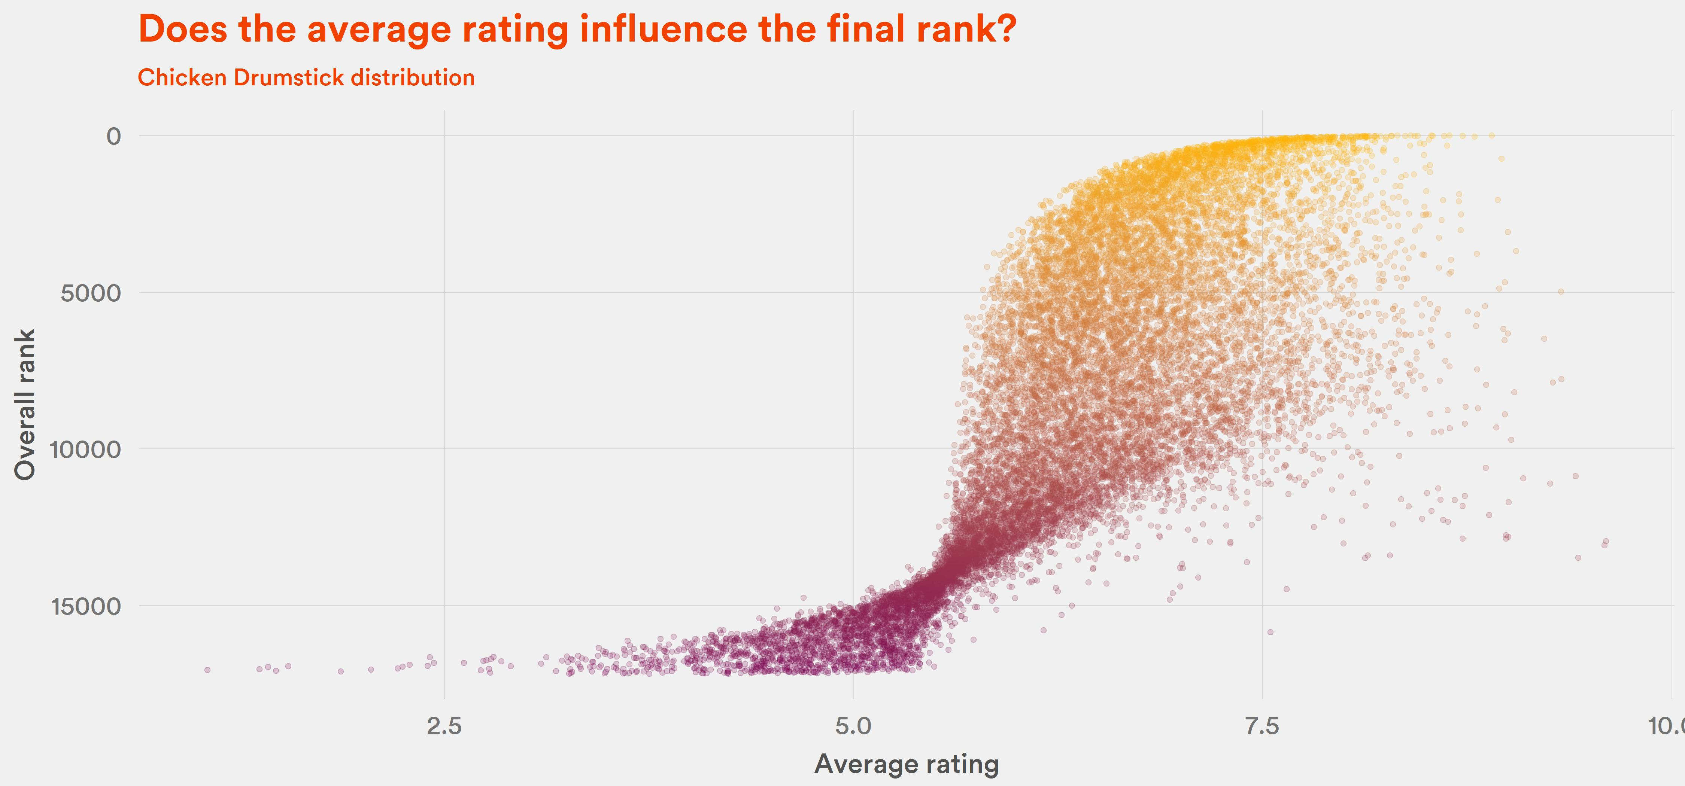
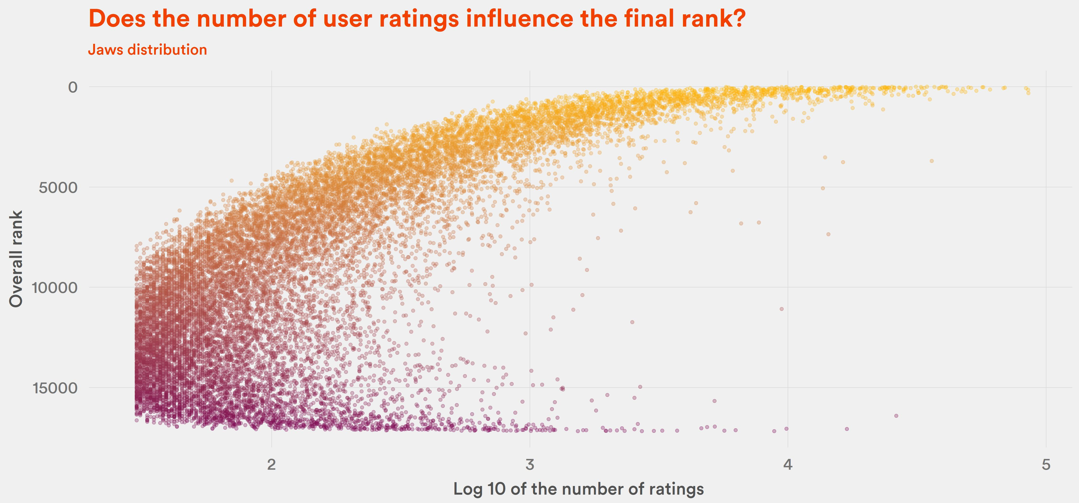
Yes, but not in a straightforward way.

Slide 17
Maybe the category influences the rank?

Slide 18
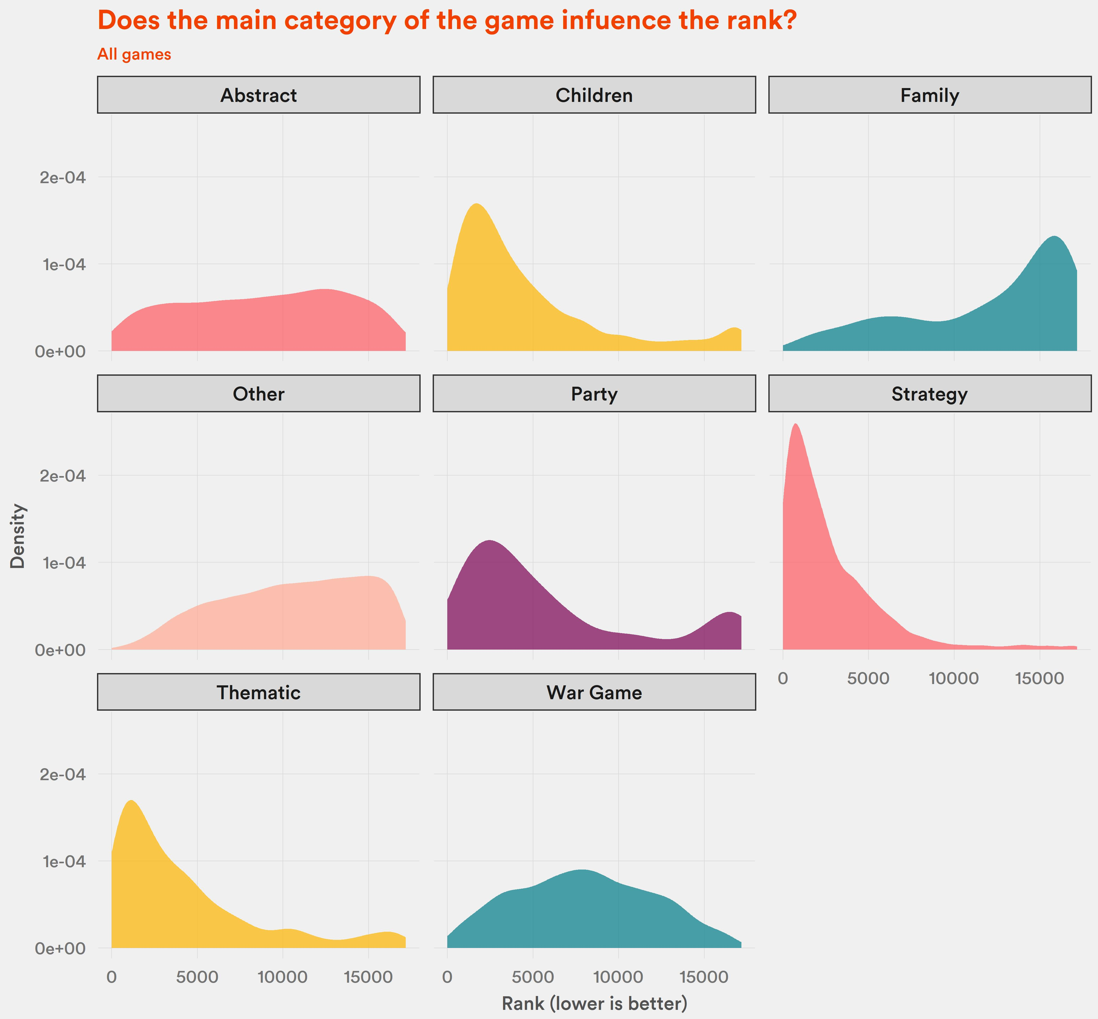
For all games - yes
Strategy is highly favoured, while family is disfavoured

Slide 19
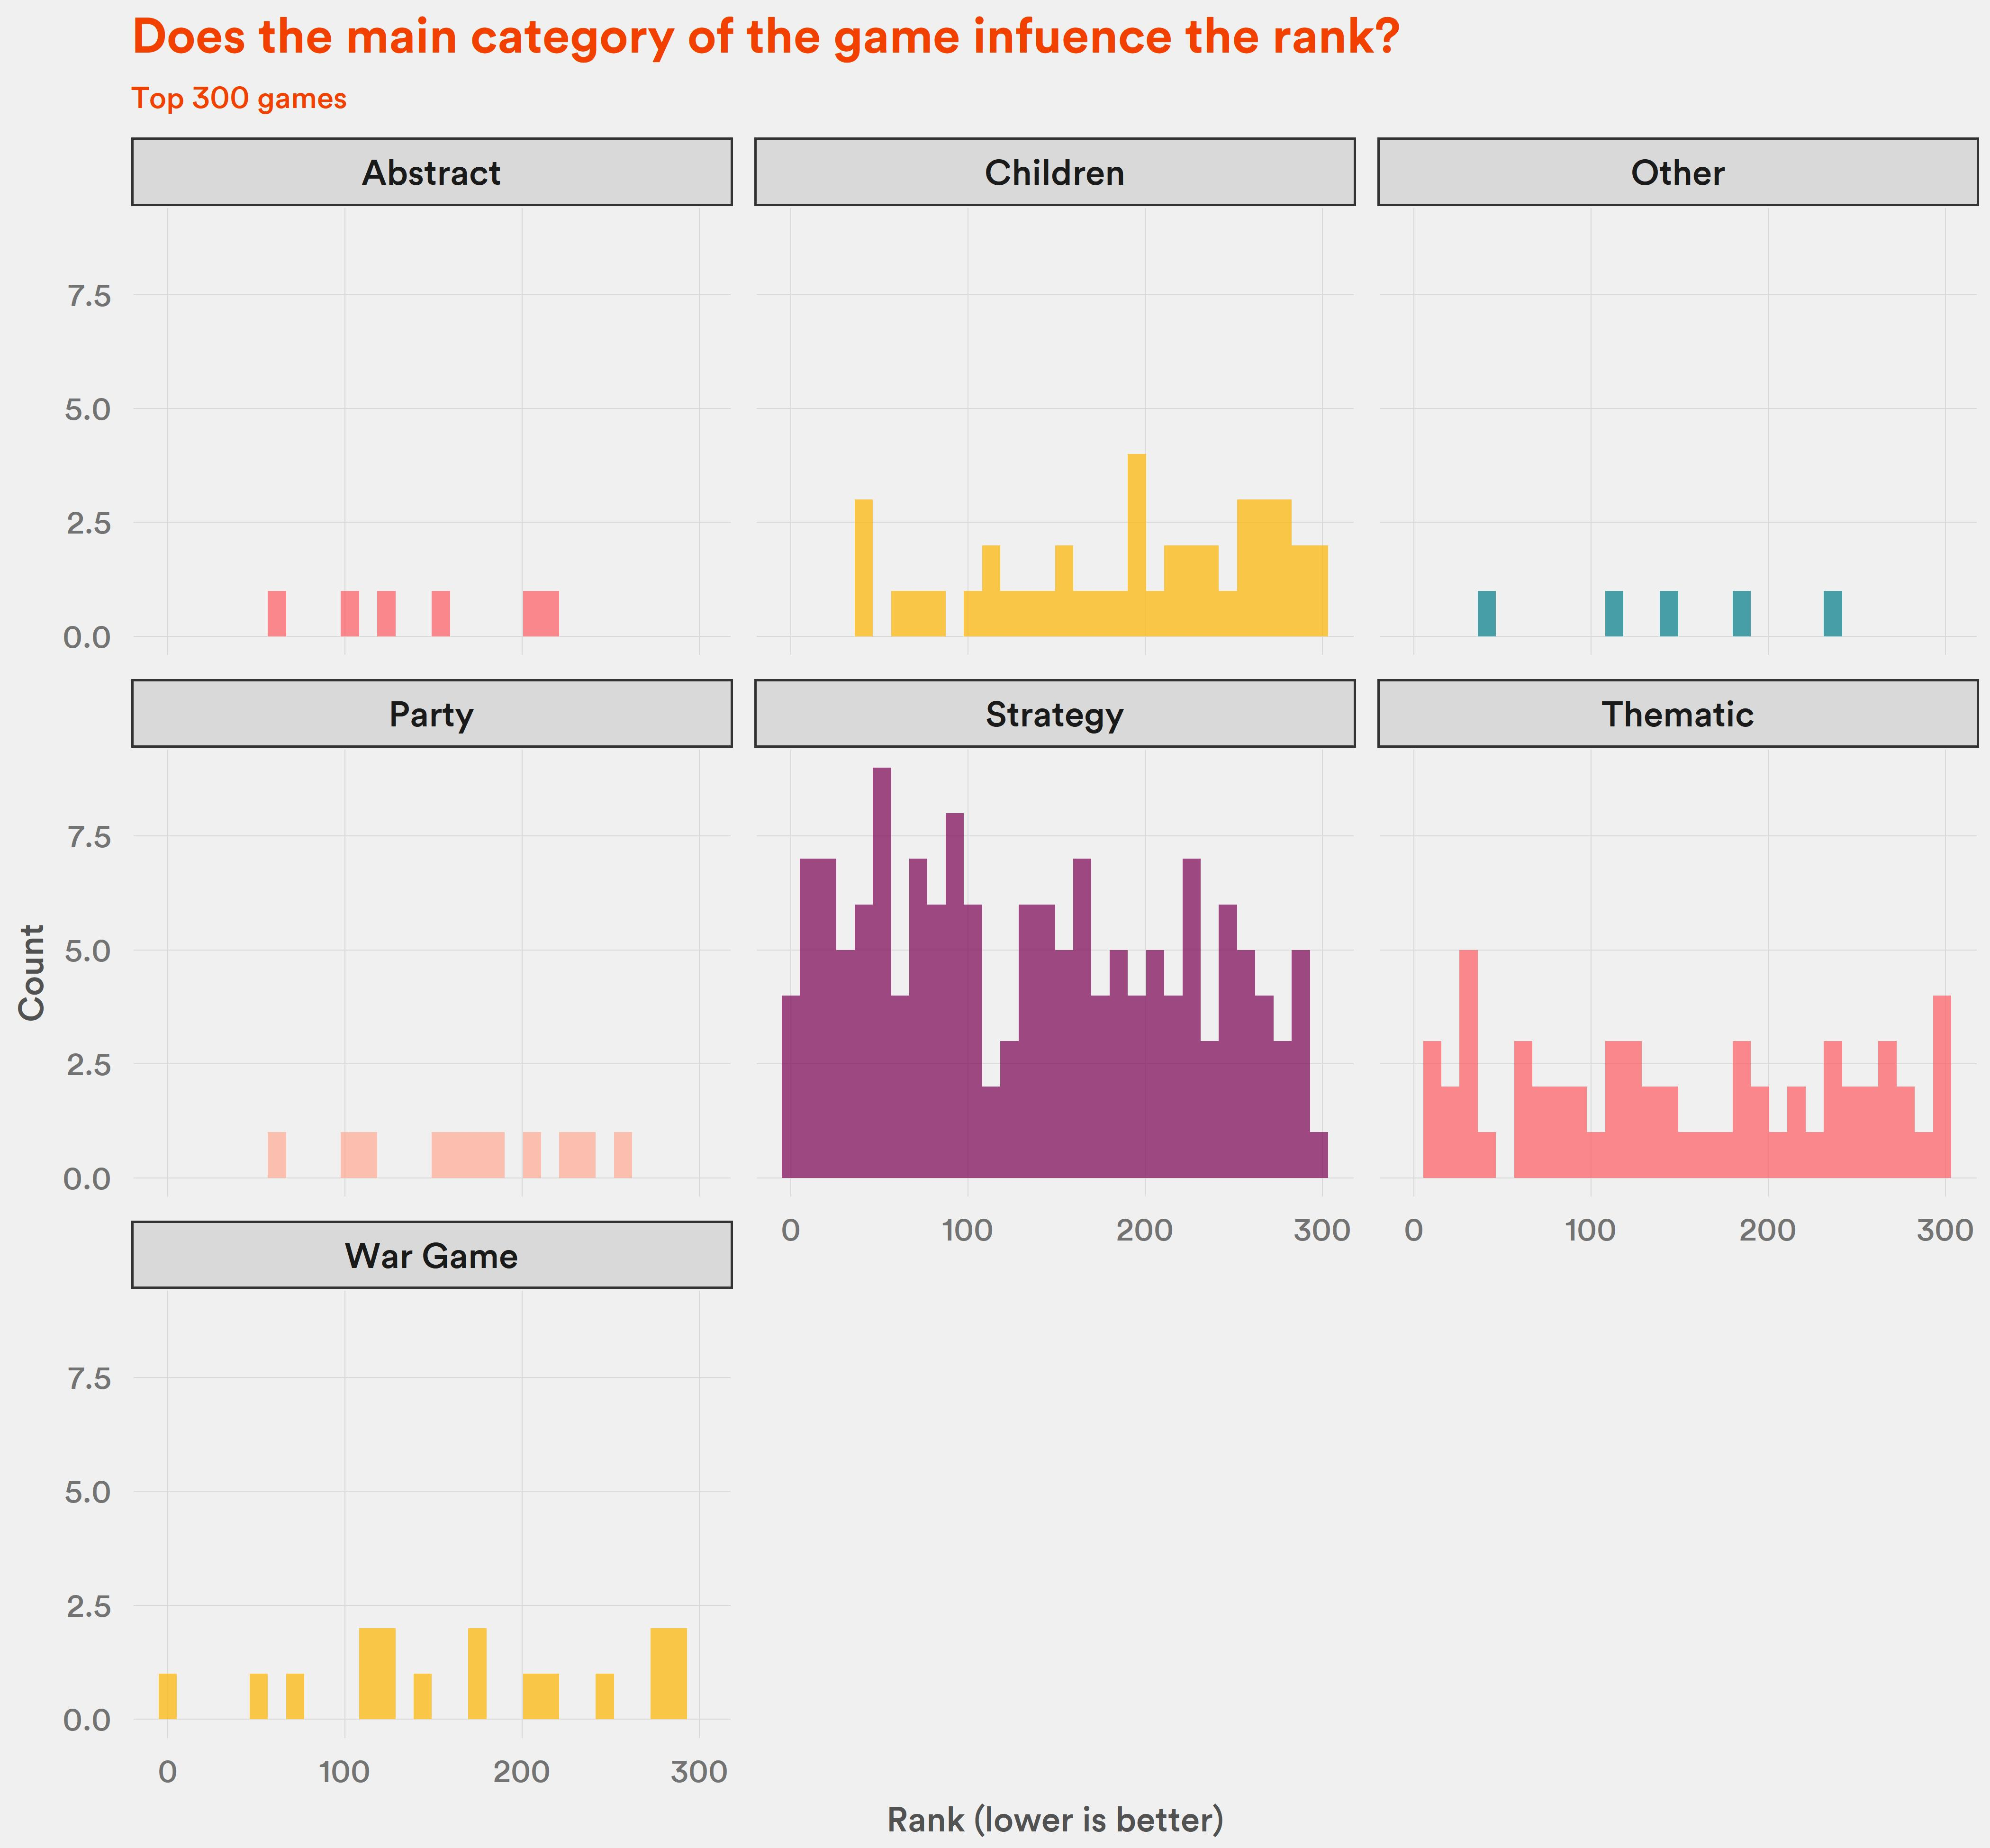
For top 1% - even more
Strategy games dominate the 1%

Slide 20
What about popularity?
People adding to their wishlists

Slide 21
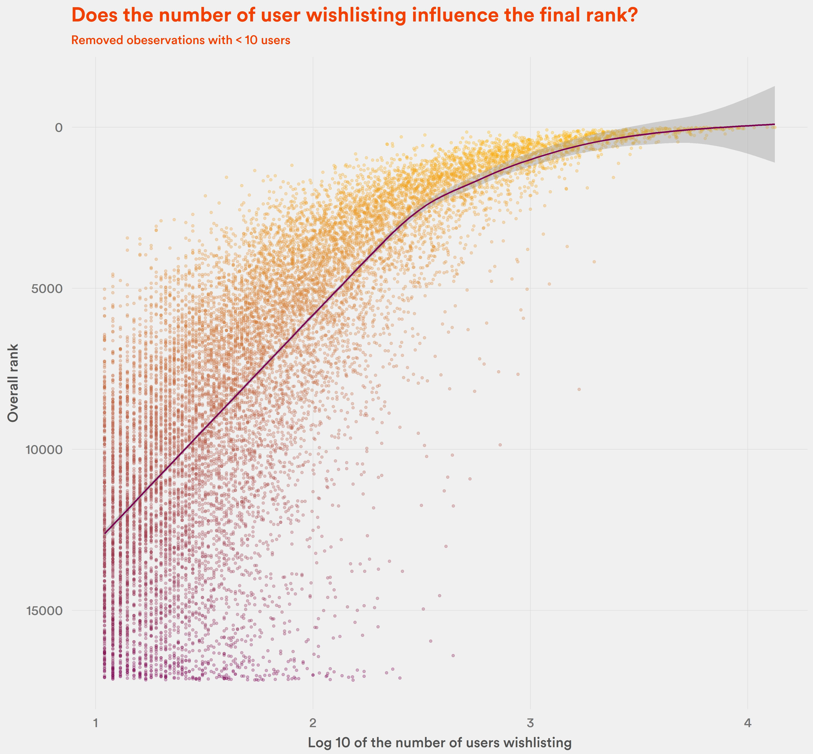
Yes
Aldought this may be a reverse correlation:
Game is high in the ranking -> People want to buy it

Slide 22
What does not influence the ranking?

Slide 23
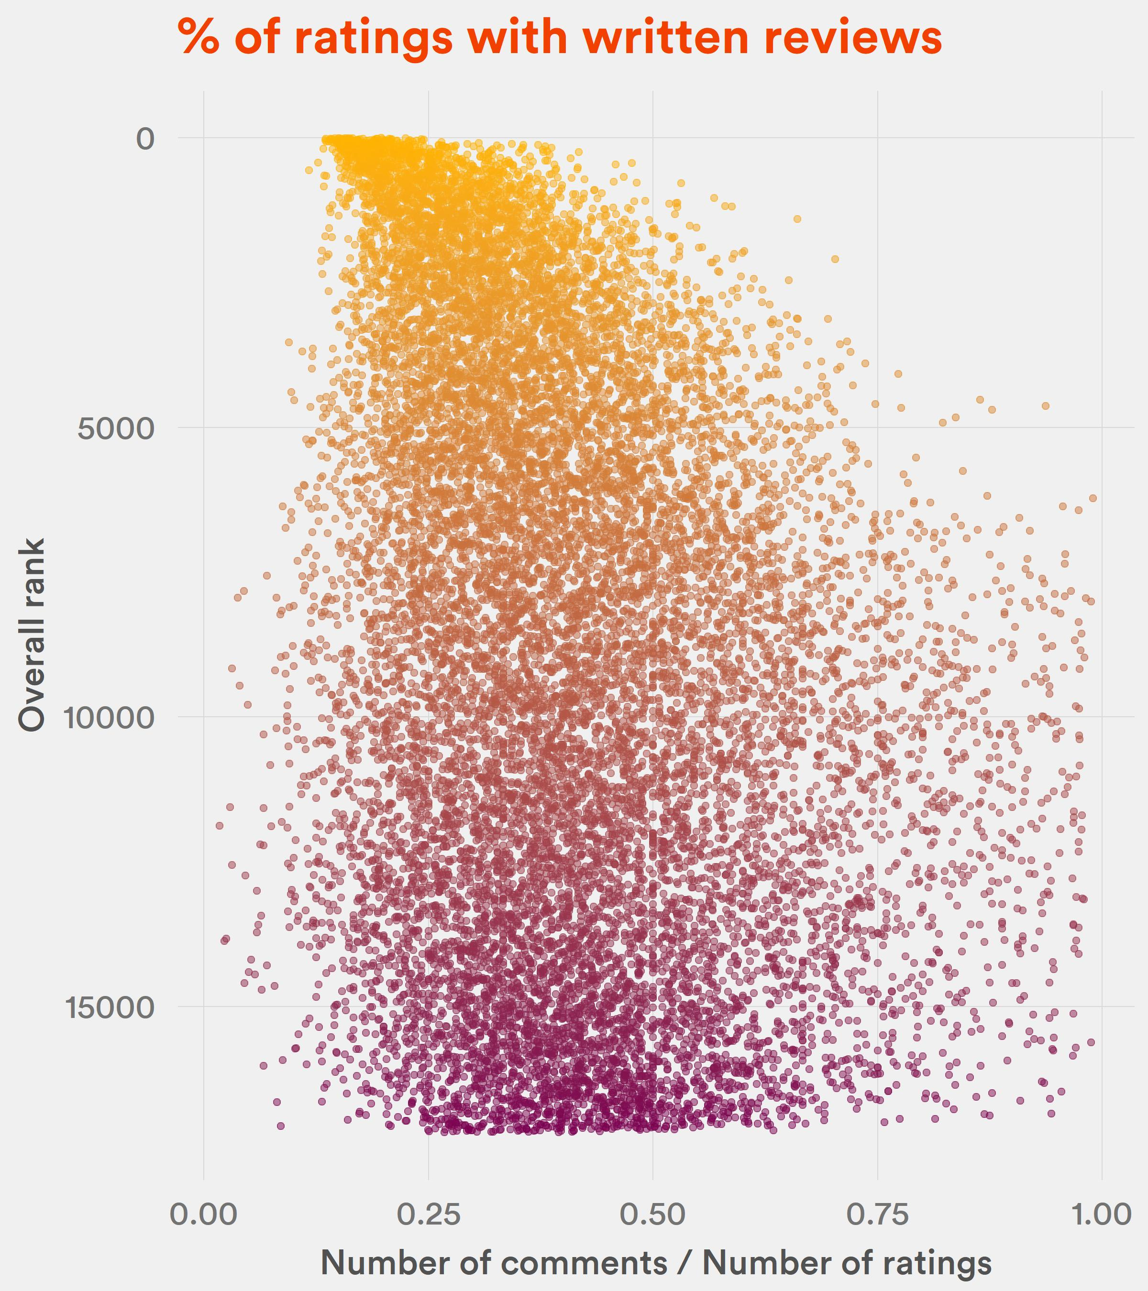
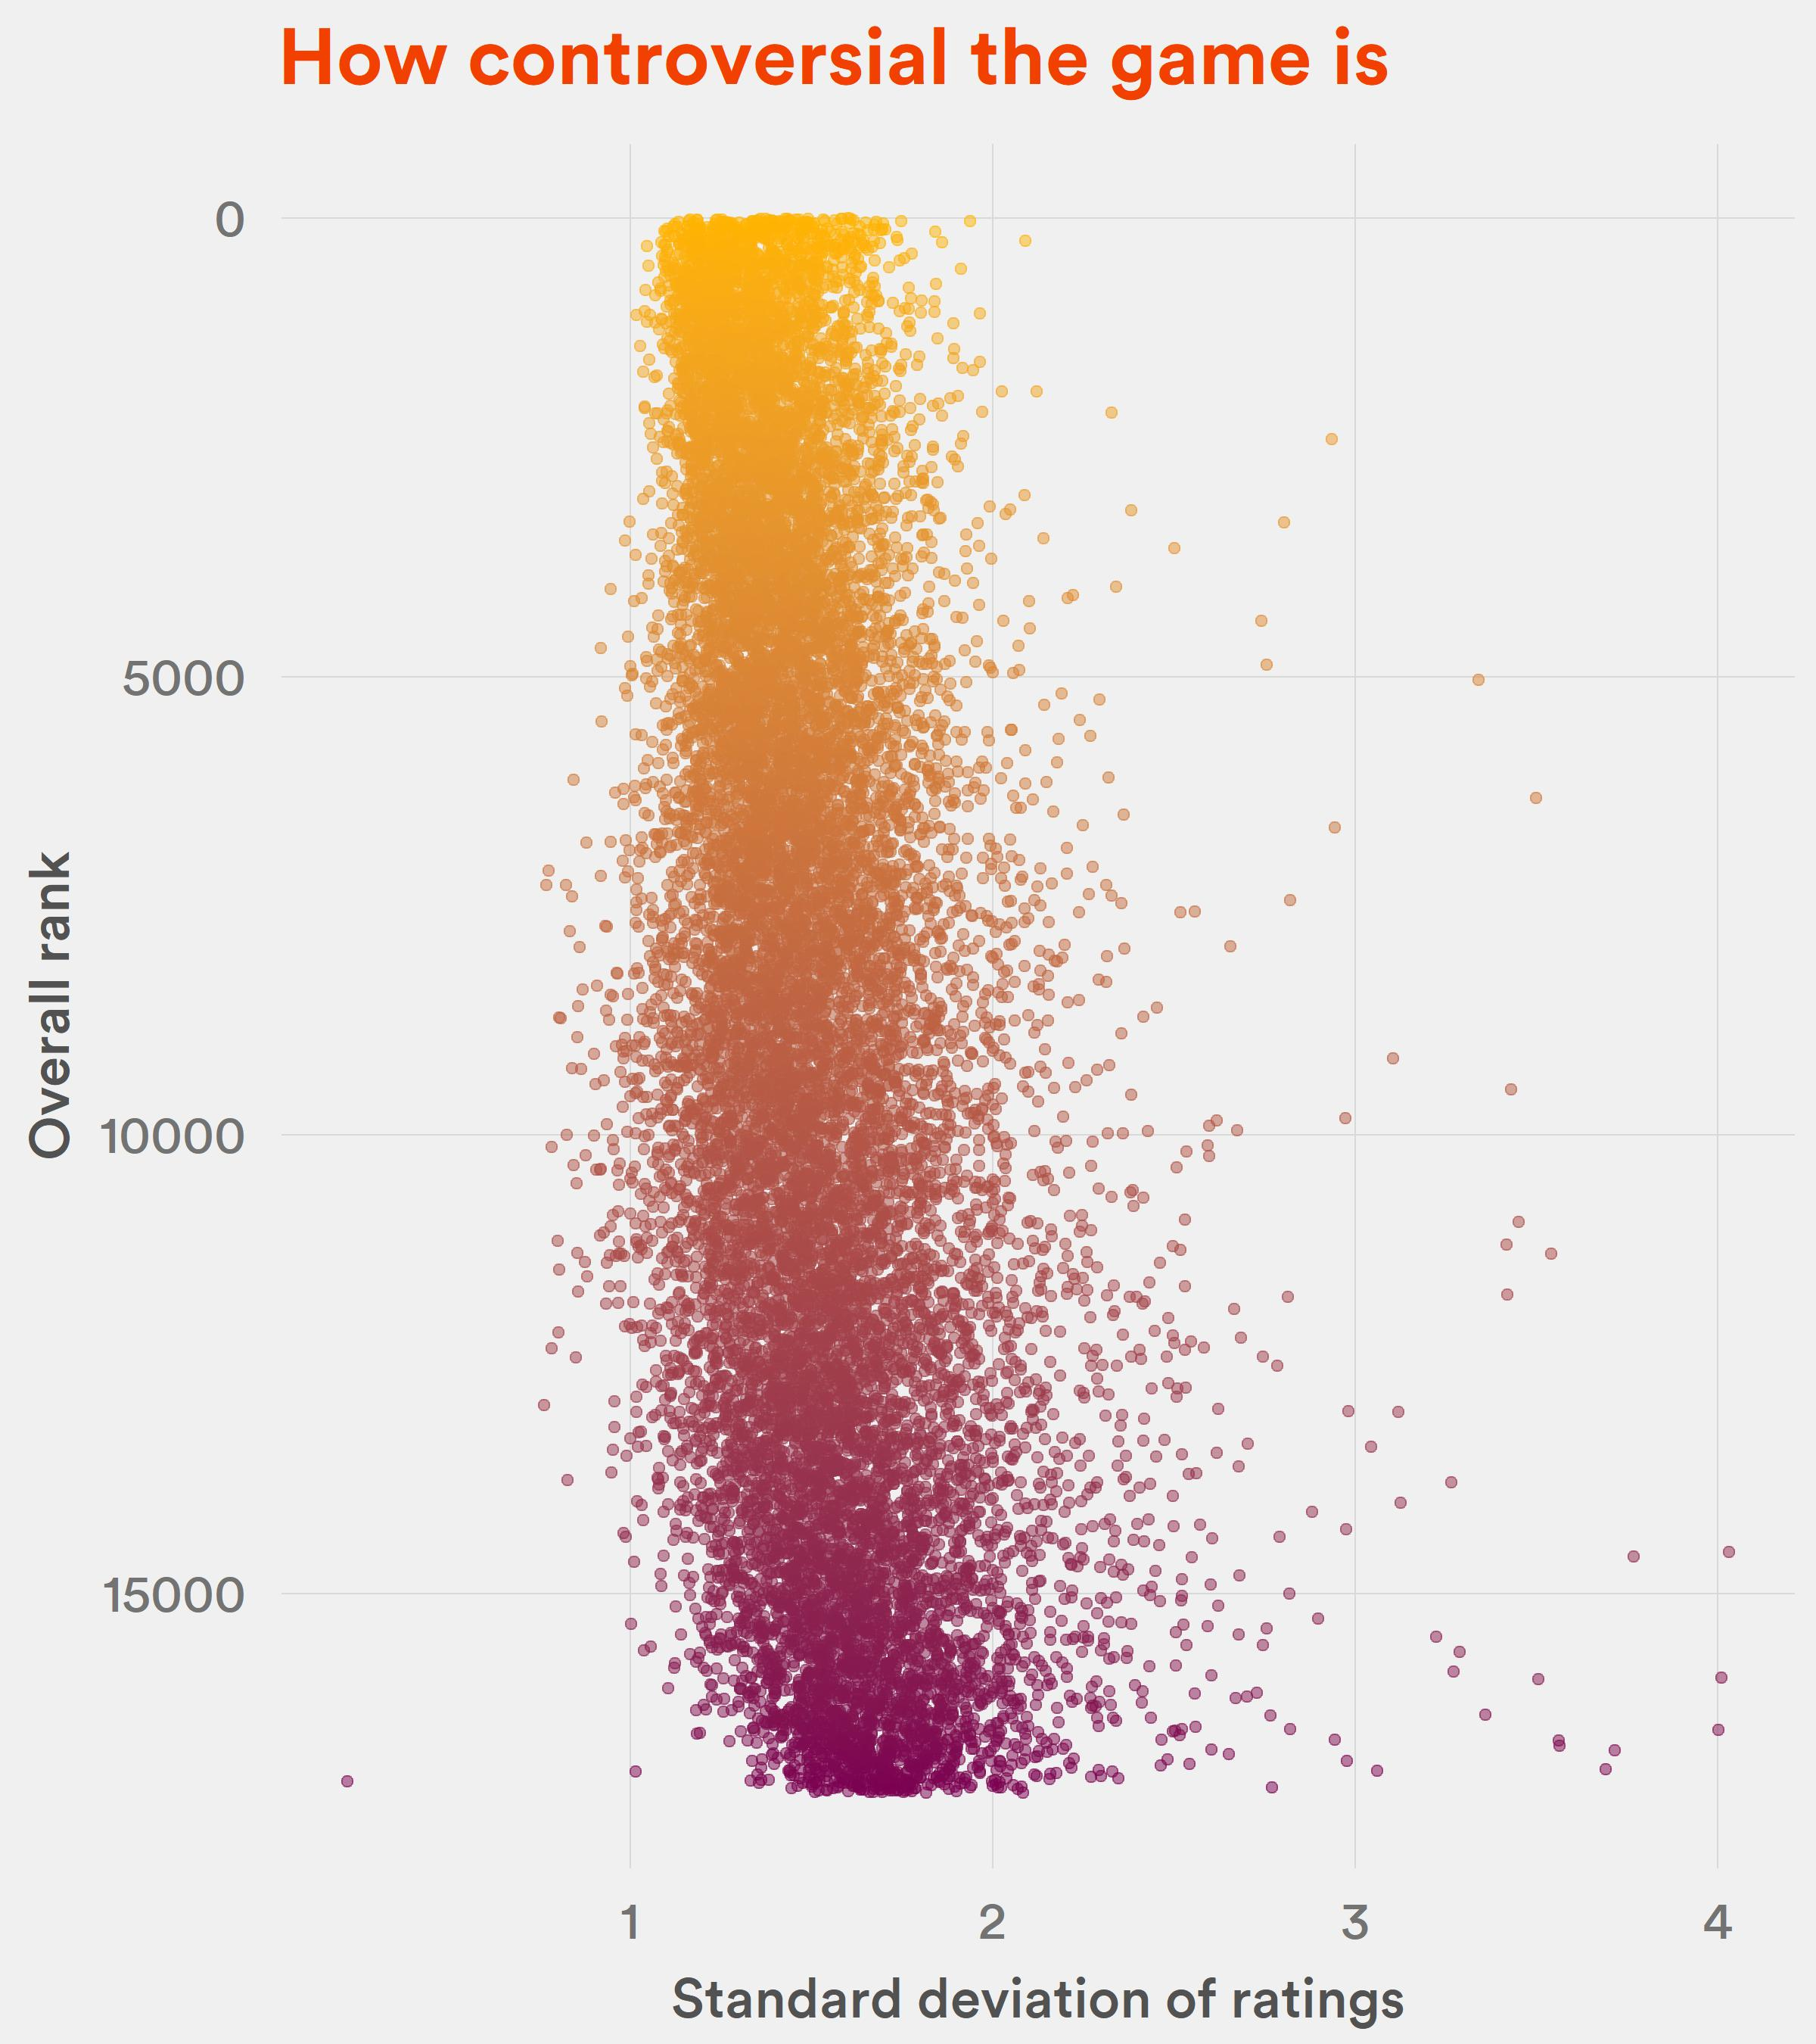

Slide 25
So, how to be in the top of BGG ranking?
Must be new, or even better – not yet published.
Must be super complex.
Must have a lot of reviews.
Must have quite good rating (but they don’t have to be the best!).
Or just be a strategy game.

